Slide 1

Negeq Bikes
Increased post-purchase customer satisfaction through an A* search with optimized heuristic designed for Alaska’s Railbelt
Alex Saelee and Gregory Gleason
* Negeq means wind of the north in Yupik.

Slide 2
The most common informed search algorithm is A* search, a best-first search that uses the evaluation function f(n) = g(n) + h(n)
Problem: After the purchase of a bike, customers are likely to purchase bike accessories. To increase customer satisfaction, we communicate offers of accessories based on known customer behavior.
Datasets: We use national data sets of customer behavior.
Approach: Due to Alaska conditions, customers have preferences which systematically vary from national averages. Hence, we develop A* search with a tailored heuristic.
Evaluation: We plan to simulate accessory purchasing.

Slide 4
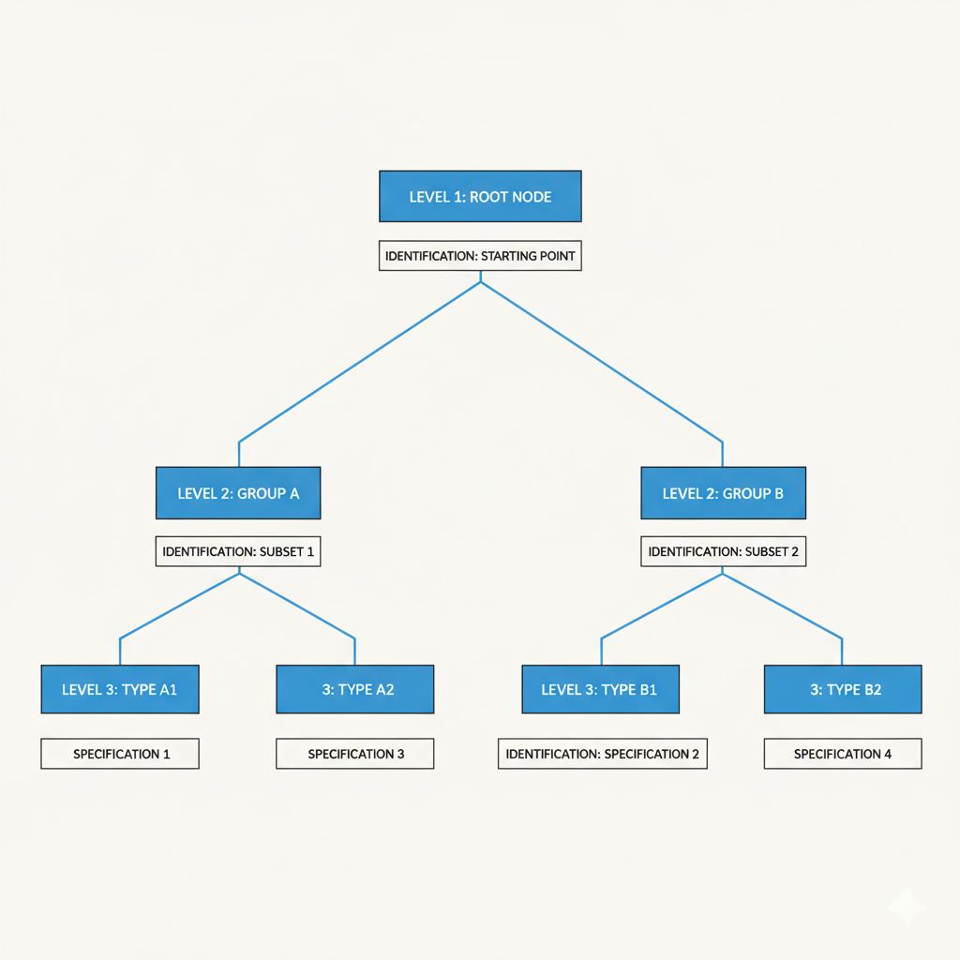

Slide 5
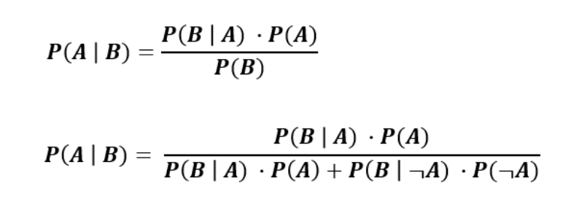
In developing our conditional probability table for h(n) we use the Bayes Rule:

Slide 6
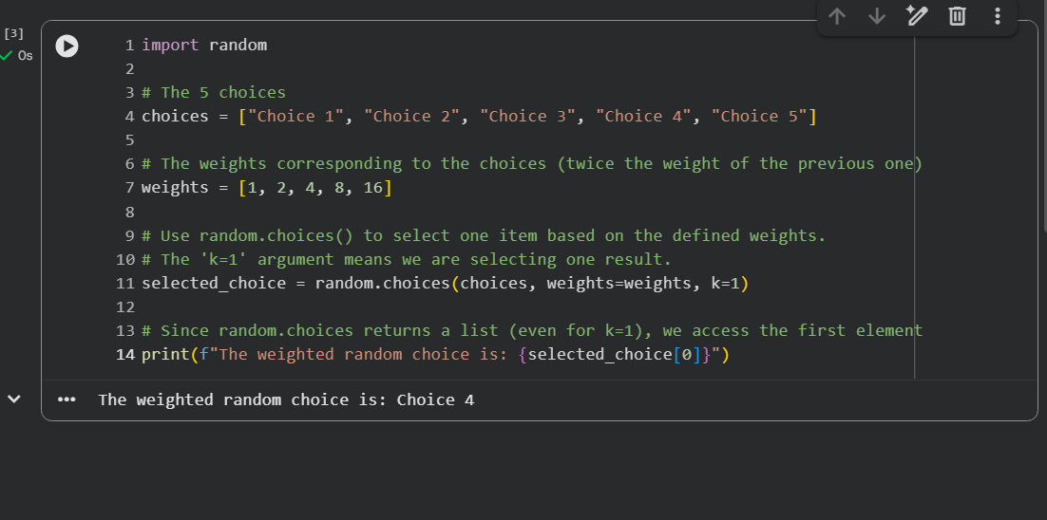
Our initial run of the selection code:

